Slide 1
Some Basic EPI Calculations

Slide 2
Some key immunization indicators
Vaccination coverage
Antigen dropout
Session dropout
Vaccine wastage (open vial/un-open vial)
Timeliness and completeness of surveillance reporting system
Other surveillance indicators

Slide 3
Where data are available?
Immunization chart and table
Daily register
Permanent register
Tally Sheet
Monthly immunization report
Vaccination card (child/woman)
Weekly surveillance report
Case investigation forms

Slide 4
Which one of the below is a good indicator for assessing access to immunization service?
OPV1 coverage
Penta 1 coverage
Penta 3 coverage
Measles 1 coverage

Slide 5
Which statement is correct?
A high drop-out rate (Penta1 to Penta3 is 25%)
Indicates a poor access to immunization services
Indicates a poor utilization of immunization services
Indicates a problem of denominator
Could be due to a data quality problem

Slide 6
Key immunization indicators in RED/REC approach
Penta1 coverage: to assess accessibility to the immunization service
Penta1 to Penta3 dropout: to assess utilization of the immunization service
Based on these two indicators an area can be classified as either of the followings,
1. High access (>80% coverage) and high utilization (<10% dropout)
2. High access (>80% coverage) and low utilization (>10% dropout)
3. Low access (<80% coverage) and high utilization (<10% dropout)
4. Low access (<80% coverage) and low utilization (>10% dropout)

Slide 7
How to calculate denominator?
What is the denominators for different antigens?
  BCG and OPV0: annual live birth (3.5% of total population)
  OPV, Penta and PCV10 1st, 2nd and 3rd doses, IPV-1, Measles 1st and 2nd doses: annual surviving infants (94.2% of annual live birth)
  TT: annual pregnant women (@ 1.02 as factor of birth)

Slide 8
How to calculate denominator?
Annual live births
  Total population x 3.5 / 100
Annual surviving infants
  Annual live births x (1 – neonatal mortality rate)
Annual pregnant women
  Annual live births x 1.02
To get monthly target divide annual target by 12

Slide 9
Exercise (participants to calculate)
Village/ Mohallah | Total population | Annual Live Births | Annual Surviving Infants | Annual P/L Women
A | 3657
B | 4689
C | 7387
D | 5432
E | 3742
F | 1988

Slide 10
Exercise (solution)
Village/ Mohallah | Total population | Annual Live Births | Annual Surviving Infants | Annual P/L Women
A | 3657 | 128 | 121 | 131
B | 4689 | 164 | 155 | 167
C | 7387 | 259 | 244 | 264
D | 5432 | 190 | 179 | 194
E | 3742 | 131 | 123 | 134
F | 1988 | 70 | 66 | 71

Slide 11
Which one is the denominator for Penta3 coverage estimation?
Annual live birth
Annual surviving infants
Children born in the previous year
Children who received Penta 1

Slide 12
How to calculate coverage?
We need:
Numerator: number of children vaccinated
Denominator: number of children targeted to be vaccinated
Expressed in %

Slide 13
How to calculate coverage?
For example:
BCG monthly coverage:
number of children vaccinated with BCG vaccine x 100
divided by monthly live births
Penta 3 coverage:
number of children vaccinated with penta 3 dose x 100
divided by monthly surviving infants

Slide 14
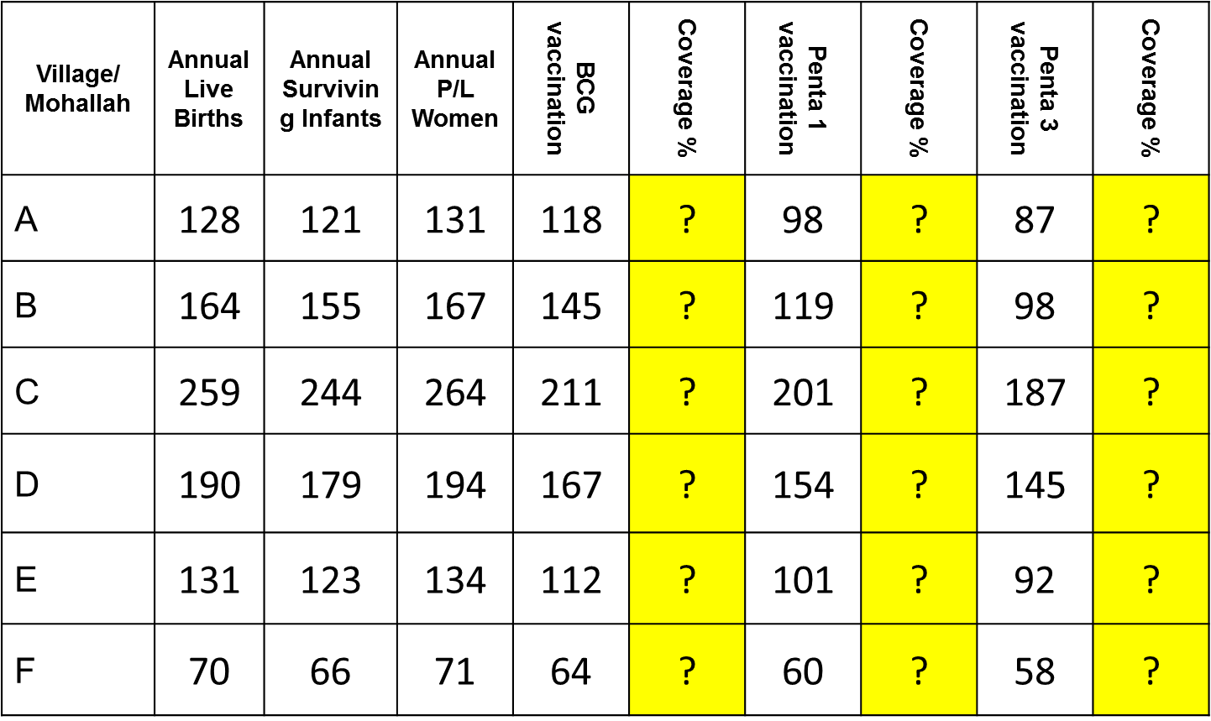
Exercise (participants to calculate)

Slide 15
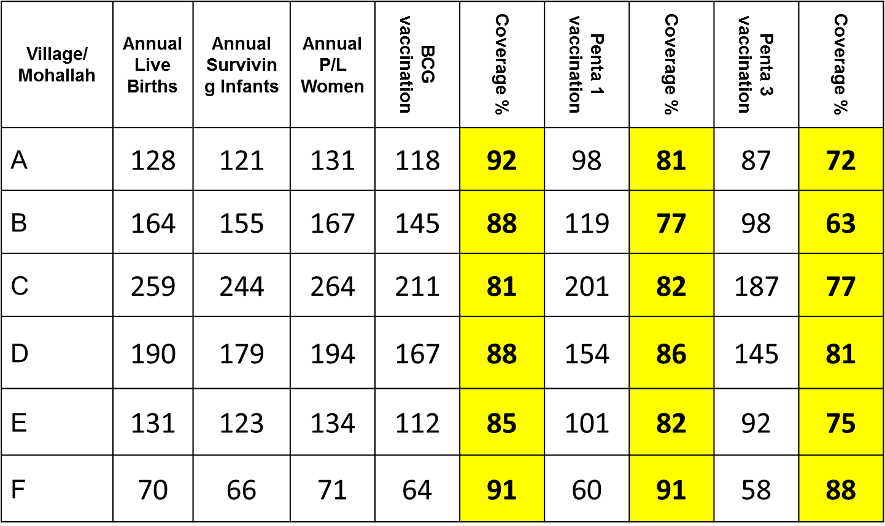
Exercise (participants to calculate)

Slide 16
Antigen dropout
Antigen dropout is usually calculated between two antigens or two doses of same antigen against a specific period and expressed in percentage
This is the percentage of children who received the 1st antigen/dose but missed the 2nd antigen/dose during a specified period
Maximum acceptable limit for any antigen dropout is 10%

Slide 17
Example 1: Dropout in Penta 1 to Penta3 in 2016 in district Kohat,
(Total number of children received Penta1 vaccination in 2016 in district Kohat) – (Total number of children received Penta3 vaccination in 2016 in district Kohat)
=
X 100
Total number of children received Penta1 vaccination in 2016 in district Kohat

Slide 18
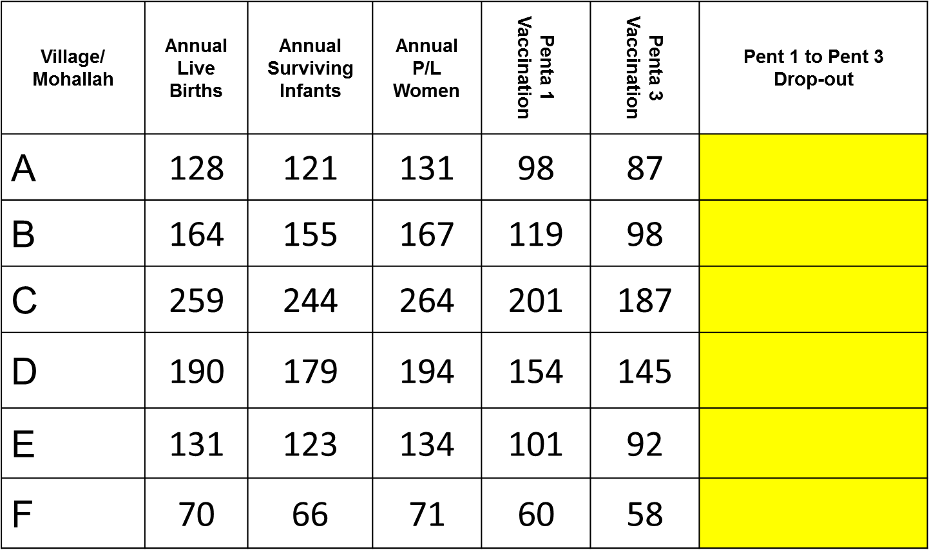
Exercise (solution)

Slide 19

Exercise (solution)

Slide 20
Session dropout
Session dropout usually calculated for outreach sessions. It can be done for a specific month or cumulative up to a month of the year
Month specific session dropout is number of planned outreach sessions was not held in a particular month over total number of outreach sessions planned in that same month expressed in percentage
Cumulative session dropout up to a month is total number of planned outreach sessions was not held from the beginning of the year up to a specific month over total number of outreach sessions planned during the same period expressed in percentage

Slide 21
Example 1: session dropout in the month of August ’15 in district Buner,
(Total number of outreach sessions planned for the month of August ’16 in district Peshawar) – (Total number of outreach sessions actually held in the month of August ‘16 in district Peshawar)
=
X 100
Total number of outreach sessions planned for the month of August ’16 in district Peshawar
Example 2: cumulative session dropout up to the month of August ’15 in district Buner,
(Total number of outreach sessions planned for January to August ’16 in district Peshawar) – (Total number of outreach sessions actually held during January to August ‘16 in district Peshawar)
=
X 100
Total number of outreach sessions planned for January to August ’16 in district Peshawar
Ask the participants to make a practical calculation

Slide 22
EPI-KHYBER PAKHTUNKHWA
MONTHLY IMMUNIZATION COVERAGE OF CHILDREN (0-11 MONTHS) 2015
Name of EPI Center: Chamkani |  |  | Monthly Target: 119 |  | District: Peshawar
S. No | MONTH | BCG | PENTA 1 | PENTA 2 | PENTA 3 | MEASLES 1
1 | JANUARY | 110 | 87 | 69 | 77 | 124
2 | FEBRUARY | 84 | 107 | 74 | 74 | 78
3 | MARCH | 225 | 230 | 207 | 153 | 153
4 | APRIL | 114 | 134 | 134 | 164 | 159
5 | MAY | 154 | 195 | 181 | 140 | 105
6 | JUNE | 134 | 174 | 146 | 131 | 119

Slide 23
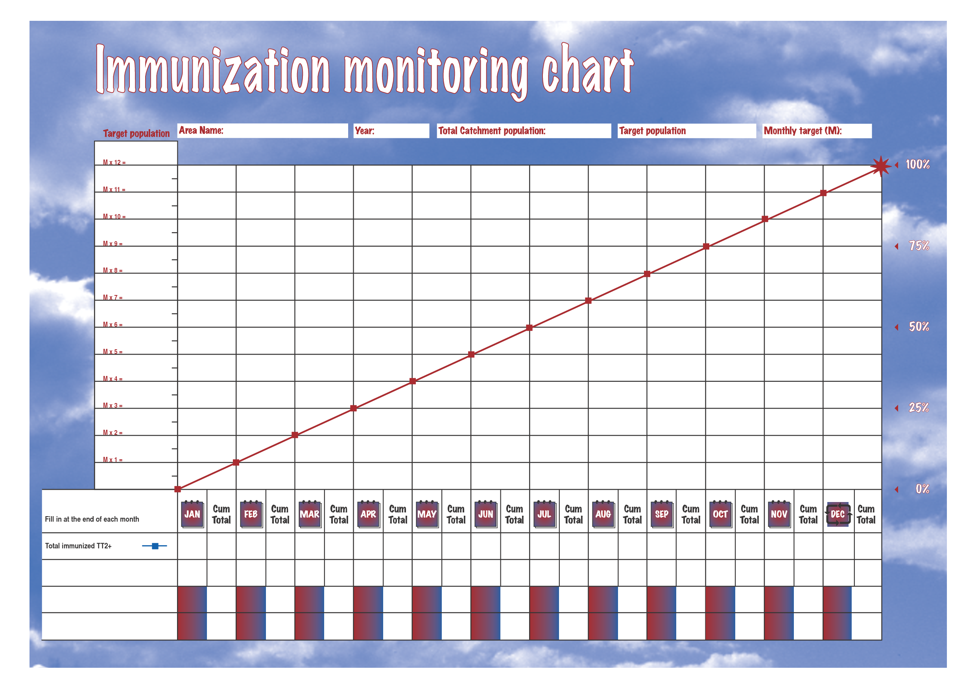

Slide 24
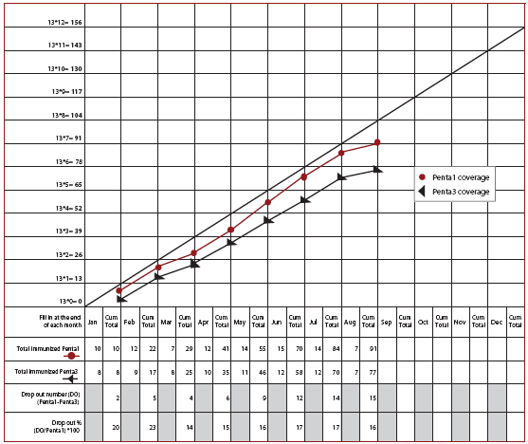

Slide 25
Cumulative coverage
Cumulative coverage of an antigen up to a specific month is the total number of children vaccinated from the beginning of the year up to that month divided by the total target of the whole year expressed in percentage
Example: cumulative coverage of Pentavalent 3 up to the month of July ’15 in district Bannu,
Total number of children received Pentavalent 3 vaccination during January to July in 2015 in district Bannu
=
X 100
Total target for Pentavalent 3 vaccination in the year of 2015 in district Bannu
Ask the participants to make a practical calculation

Slide 26
Estimating vaccine & injection equipment needs
There are two methods for estimating vaccine and injection equipment needs
Estimation based on target population
  More accurate and preferred method
  Calculation is a bit complicated
Estimation based on previous consumption
  Less accurate and based on previous performance
  Easy to calculate

Slide 27
Estimation based on target population
Data required:
  Target population
  Number of doses of each vaccine for each target child
  Doses per vial
  Wastage factor for each vaccine
Wastage factor = 100/(100 – wastage rate)
Vaccine | Presentation (doses/vial)* | Acceptable wastage rate** | Wastage factor**
BCG | 20 | 50% | 2
Hepatitis B |  | 10% | 1.11
OPV | 20 | 20% | 1.25
Pentavalent (DTP+HepB+Hib) | 1 | 5% | 1.05
Measles | 10 | 20% | 1.25
PCV-10 | 2 | 10% | 1.11
IPV | 10 | 10% | 1.11
TT | 20 | 20% | 1.25

Slide 28
Exercise: Estimation of vaccine needs of a district for a month based on target population
Monthly target
  Children: 100,000
  Pregnant women: 102,000
Vaccine | Target Population | Number of Doses | Doses per vial | Wastage Factor | Expected coverage | Doses needed | Current stock | Actual Doses needed | Actual number of vials needed
 |  |  |  |  |  |  | (Doses)
A | B | C | D | E | F | G=BxCxExF | H | I=G-H | J=Roundup I/D
BCG | 100,000 | 1 | 20 | 2 | 95% |  | 15,000
OPV | 100,000 | 4 | 20 | 1.25 | 90% |  | 34,000
Penta | 100,000 | 3 | 1 | 1.05 | 90% |  | 27,000
PCV10 | 100,000 | 3 | 2 | 1.11 | 90% |  | 54,000
Measles | 100,000 | 2 | 10 | 1.25 | 90% |  | 40,000
IPV | 100,000 | 1 | 10 | 1.11 | 90% |  | --
TT | 125,000 | 2 | 20 | 1.25 | 80% |  | 53,000

Slide 29
Exercise: Estimation of vaccine needs of a district for a month based on target population
Monthly target
  Children: 100,000
  Pregnant women: 102,000
Vaccine | Target Population | Number of Doses | Doses per vial | Wastage Factor | Expected coverage | Doses needed | Current stock | Actual Doses needed | Actual number of vials needed
 |  |  |  |  |  |  | (Doses)
A | B | C | D | E | F | G=BxCxExF | H | I=G-H | J=Roundup I/D
BCG | 100,000 | 1 | 20 | 2 | 95% | 190,000 | 15,000 | 175,000 | 8,750
OPV | 100,000 | 4 | 20 | 1.25 | 90% | 450,000 | 34,000 | 416,000 | 20,800
Penta | 100,000 | 3 | 1 | 1.05 | 90% | 283,500 | 27,000 | 256,500 | 256,500
PCV10 | 100,000 | 3 | 2 | 1.11 | 90% | 299,700 | 54,000 | 245,700 | 122,850
Measles | 100,000 | 2 | 10 | 1.25 | 90% | 225,000 | 40,000 | 185,000 | 18,500
IPV | 100,000 | 1 | 10 | 1.11 | 90% | 99,900 | -- | 99,900 | 9,990
TT | 125,000 | 2 | 20 | 1.25 | 80% | 250,000 | 53,000 | 197,000 | 9,850

Slide 30
Estimation based on previous consumption
Data required:
  Initial stock
  Stock received during the period
  Stock at the end of the period
Wastage factor: this method automatically considers vaccines that have been wasted during the previous period so there is no need to include wastage factor

Slide 31
Example: Estimation of vaccine needs of a district for month of January based on previous consumption
Vaccine | Stock at the beginning of December | Stock received during December | Stock at the end of December | Need for January
 | (Vial) | (Vial) | (Vial) | (Vial)
A | B | C | D | E=B+C-D
BCG | 1,700 | 10,500 | 2,300
OPV | 3,500 | 33,500 | 4,600
Penta | 2,700 | 31,200 | 900
PCV10 | 1,350 | 15,600 | 450
Measles | 1,150 | 21,600 | 2,437
IPV | -- | -- | --
TT | 5,500 | 28,000 | 6,315

Slide 32
Example: Estimation of vaccine needs of a district for month of January based on previous consumption
Vaccine | Stock at the beginning of December (Vial) | Stock received during December (Vial) | Stock at the end of December (Vial) | Need for January (Vial)
A | B | C | D | E=B+C-D
BCG | 1,700 | 10,500 | 2,300 | 9,900
OPV | 3,500 | 33,500 | 4,600 | 32,400
Penta | 2,700 | 31,200 | 900 | 33,000
PCV10 | 1,350 | 15,600 | 450 | 16,500
Measles | 1,150 | 21,600 | 2,437 | 20,313
IPV | -- | -- | -- | 6,438
TT | 5,500 | 28,000 | 6,315 | 27,185

Slide 33
Estimation of need for injection Equipment
Injection equipment need can be estimated as following,
  One 0.05 ml AD syringe for each dose of BCG
  One 0.5 ml AD syringe for each dose of Penta, PCV10, Measles, IPV and TT
  One reconstitution syringe (2 ml for BCG & 5 ml for Measles) for each vial
  One safety box for every 100 syringes

Slide 34
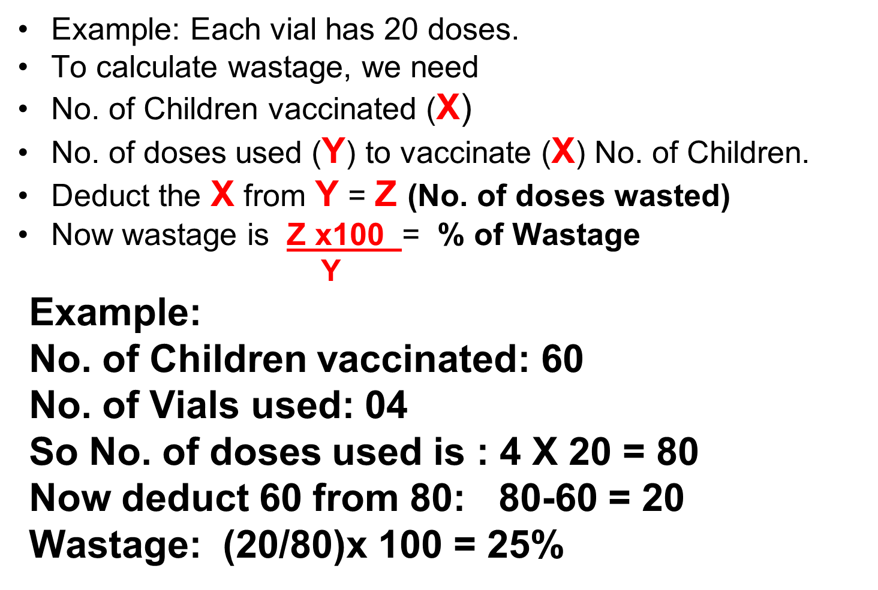
How to Calculate Vaccine Wastage

Slide 35

Thank You

